Slide 1
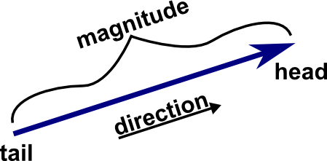
Vectors
Mrs. Parami Wattetenne
Lecturer (Probationary)
Department of Multidisciplinary Studies
Faculty of Technology
University of Ruhuna

Slide 2
What is Vectors
A vector is an object that has both a magnitude and a direction. Geometrically, we can picture a vector as a directed line segment, whose length is the magnitude of the vector and with an arrow indicating the direction. The direction of the vector is from its tail to its head.
Two vectors are the same if they have the same magnitude and direction.
Two examples - force and velocity. Both force and velocity are in a particular direction. The magnitude of the vector would indicate the strength of the force or the speed associated with the velocity.

Slide 3
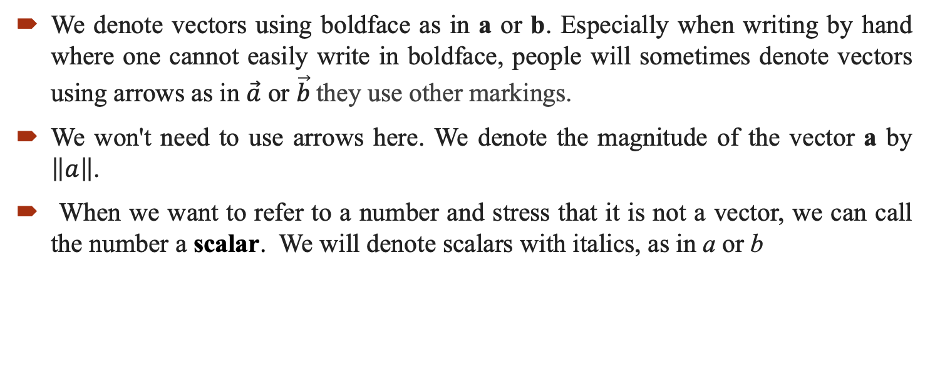
How to denote vectors?
We denote vectors using boldface as in a or b. Especially when writing by hand where one cannot easily write in boldface, people will sometimes denote vectors using arrows as in $\vec{a}$ or $\vec{b}$they use other markings.
We won't need to use arrows here. We denote the magnitude of the vector a by $\left\|a\right\|$.
When we want to refer to a number and stress that it is not a vector, we can call the number a scalar. We will denote scalars with italics, as in a or b

Slide 4
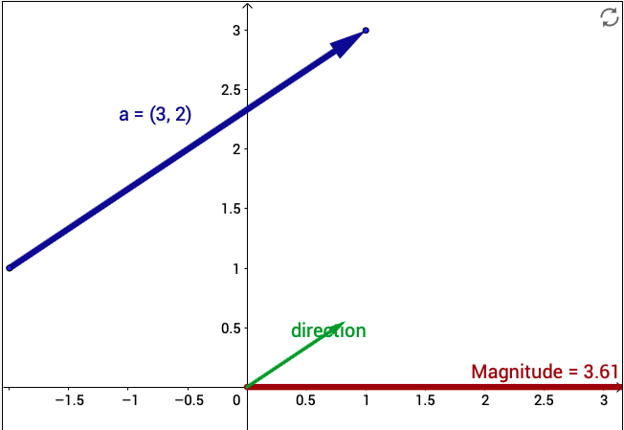
How to denote vectors?
You can explore the concept of the magnitude and direction of a vector using the below applet.
Note that moving the vector around doesn't change the vector, as the position of the vector doesn't affect the magnitude or the direction.
But if you stretch or turn the vector by moving just its head or its tail, the magnitude or direction will change.

Slide 5
Operations on Vectors
Addition
Substraction
Multiplication by a scalar

Slide 6
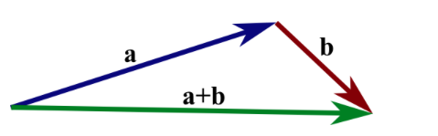
1.Addition of Vectors
Given two vectors a and b, the sum a+b, as follows.
We translate the vector b until its tail coincides with the head of a.
Then, the directed line segment from the tail of aa to the head of b is the vector a+b.

Slide 7
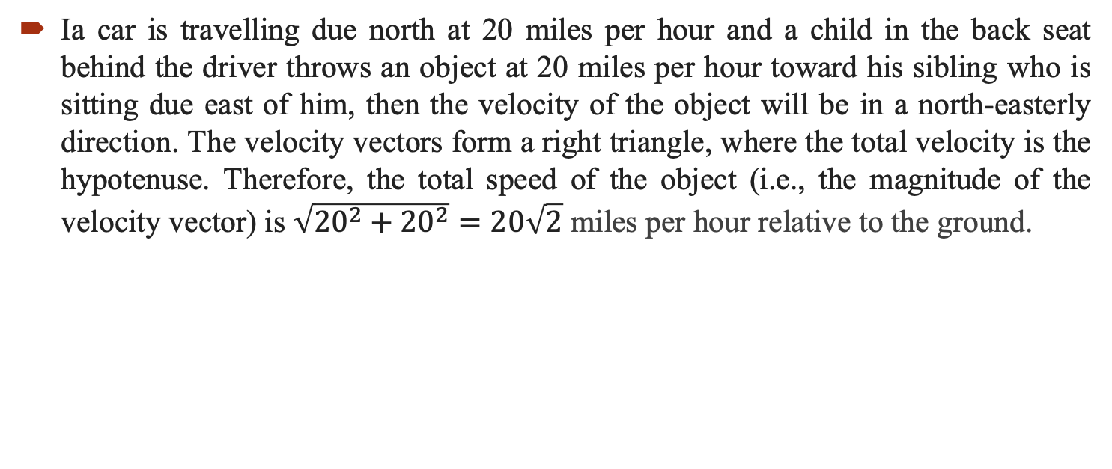
1. Addition of Vectors - Example
Ia car is travelling due north at 20 miles per hour and a child in the back seat behind the driver throws an object at 20 miles per hour toward his sibling who is sitting due east of him, then the velocity of the object will be in a north-easterly direction. The velocity vectors form a right triangle, where the total velocity is the hypotenuse. Therefore, the total speed of the object (i.e., the magnitude of the velocity vector) is $\sqrt{{20}^{2}+{20}^{2}}=20\sqrt{2}$ miles per hour relative to the ground.

Slide 8
1. Addition of Vectors
Addition of vectors satisfies two important properties.
The commutative law, a+b=b+a.
The associative (a+b)+c=a+(b+c).

Slide 9
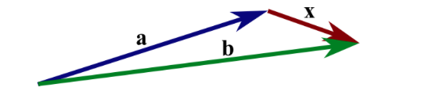
2. Vector Substraction
We define subtraction as addition with the opposite of a vector: b−a=b+(−a).

Slide 10
3. Scalar Multiplication
Given a vector a and a real number (scalar) λ, we can form the vector λa as follows.
If λ is positive, then λa is the vector whose direction is the same as the direction of a and whose length is λ times the length of a.
In this case, multiplication by λ simply stretches (if λ>1) or compresses (if 0<λ<1) the vector a.
If, on the other hand, λ is negative, then we have to take the opposite of a before stretching or compressing it.
In other words, the vector λa points in the opposite direction of a, and the length of λa is |λ| times the length of a. No matter the sign of λ, we observe that the magnitude of λa is |λ| times the magnitude of a: ∥λa∥=|λ|∥a||.

Slide 11
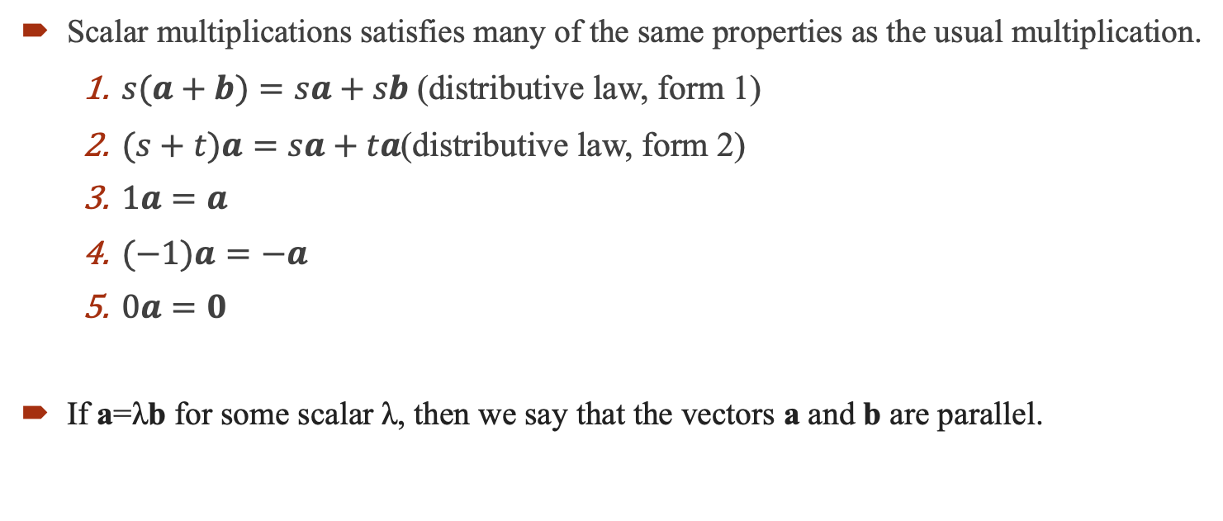
3. Scalar Multiplication
Scalar multiplications satisfies many of the same properties as the usual multiplication.
  $s(a+b)=sa+sb$(distributive law, form 1)
  $(s+t)a=sa+ta$(distributive law, form 2)
  $1a=a$
  $(−1)a=−a$
  $0a=0$
If a=λb for some scalar λ, then we say that the vectors a and b are parallel.

Slide 12
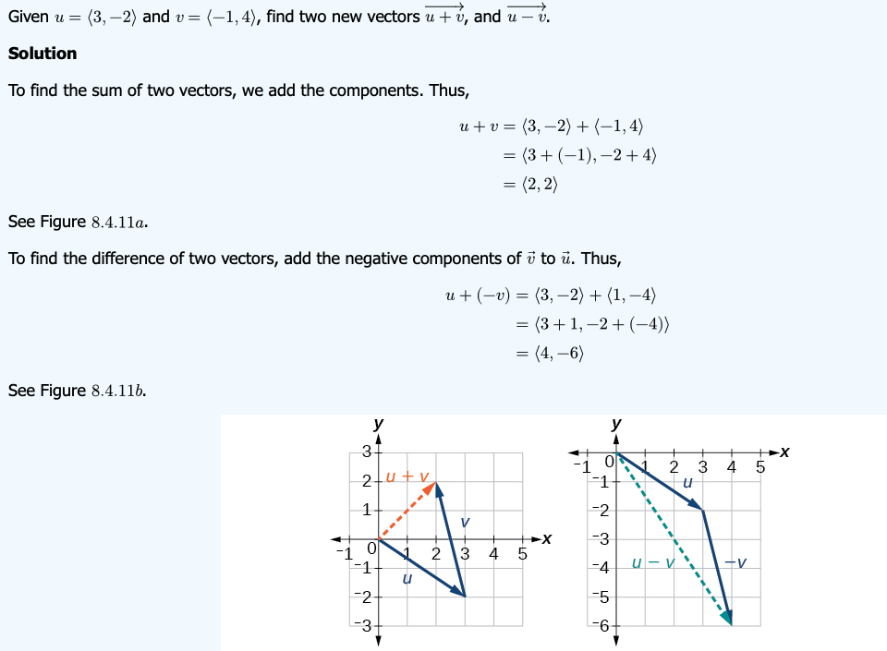
Examples

Slide 13
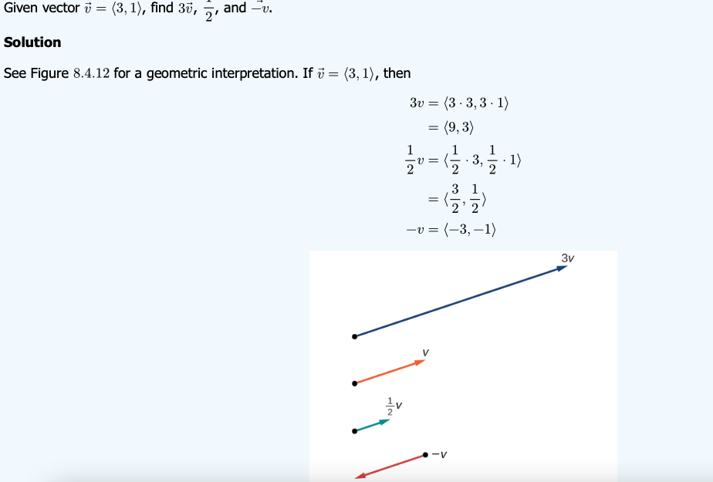
Examples

Slide 14
Thank You

